Slide 1
Mechatronic Machine Design (MMD)
Exercise 1
Deadline Jan 16, 2024, 09:00
Late submission Jan 23, 2024, 09:00

Slide 2
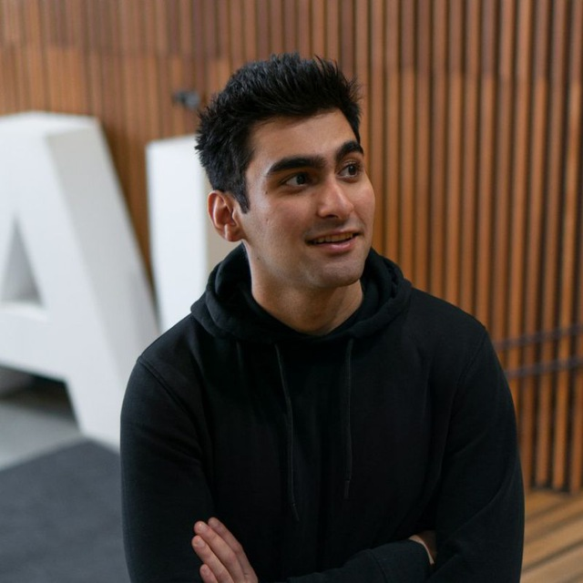
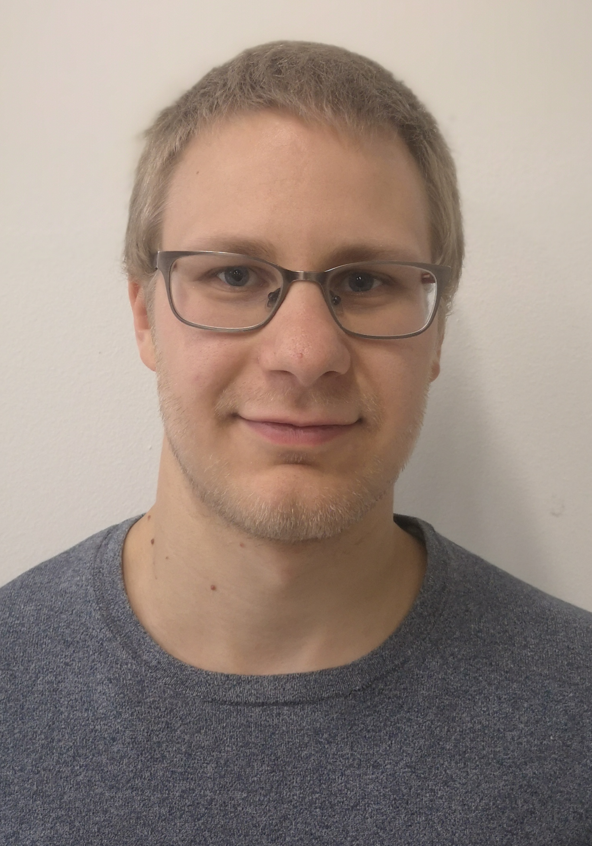
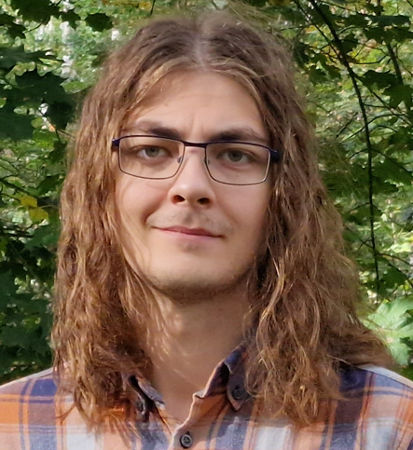
Course staff
Responsible teacher:
Kari Tammi
Dean
kari.tammi@aalto.fi
Assistant:
Riku Ala-Laurinaho
Head of DigiTwin Lab
riku.ala-laurinaho@aalto.fi
Assistant:
Pejman Habibiroudkenar
Doctoral Student
pejman.habibiroudkenar@aalto.fi
Assistant:
Joel Mattila
Doctoral Student
joel.mattila@aalto.fi

Slide 3
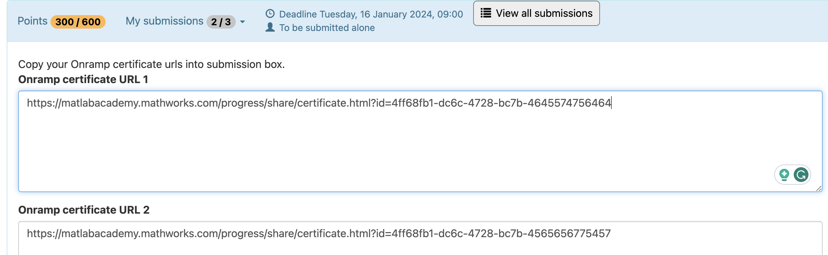
Exercise 1/MATLAB OnRamp
Install MATLAB 2023b
It is important to have the newest version because otherwise the automated assessment does not work
Recap / getting familiar with MATLAB
Complete two different MATLAB OnRamp courses
If you are complete beginner with MATLAB, we recommend MATLAB and Simulink OnRamp
Otherwise, you can select two courses that are most interesting to you
OnRamp courses can be found from:
https://matlabacademy.mathworks.com/#getting-started.
Submit the certificate links to A+:

Slide 4
Exercise 2/Simulink exercise
Model a simple powertrain using the equations provided
Define parameter values
Plot velocity profile
Learning goals:
Model simple physics-based system
Run Simulink using MATLAB script
Read data from .mat file
Use variables in Simulink models
Plot figures
Learn how to use A+ system, including the basic setup for Simulink models

